Slide 1
Parent Groups in Westminster Jan- April 2021
Live groups delivered via the Team platform
Who’s in Charge: Starting Monday 11th January 12.30pm-2.30pm. A 9 week child to parent violence (CPV) programme aimed at parents whose children are being abusive or violent toward them or who appear out of parental control. To book click here
Circle of Security: Starting Tuesday 12th January 10am-12pm. A 10 week attachment based parenting group ideally suited to parents with children under 7 years.
To book click here
Non-violent Resistance (NVR): Starting Thursday 14th January 6-8pm. A 12 week group for parents with children 11yrs+ who are displaying challenging or risky behaviour and looking for new ways to improve their relationships.
To book click here
Triple P (0-12): Starting Tuesday 12th January 1-3pm. A 10 week positive parenting programme ideally suited to parents with children under 11yrs. The programme provides practical parenting tips and strategies.
To book click here
Freedom Programme: Starting 14th January 10.30-12.30pm. An 11 week programme for women who have experienced domestic abuse in any of it’s forms, providing a reflective space and tools to identify abusive behaviour in the future.
To book contact earlyhelpparentingteam@westminster.gov.uk
Within My Reach: Starting Wednesday 20th January. An 8 session group for separated parents who would like help to work on improving their relationship with their ex-partner so they can co-parent successfully. To book contact VeneshaP@familylives.org.uk
Parenting Resource Forum: Starting Friday 12th March 1-3pm. A 3 week virtual community for parents to share new ideas and tips about topics such as: routines, dealing with conflict in relationships, play… and much more. All parents welcome.
To book click here

Slide 2
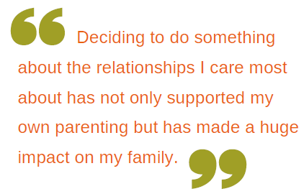
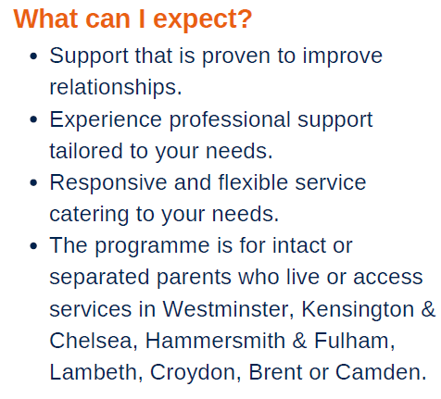
Couple & Co-parenting Relationship Support
Group for families whose parent has mental health issue
For more information contact:
rpcreferrals@westminster.gov.uk
or call 020 7641 3523
For more information contact: earlyhelpparentingteam@westminster.gov.uk

